Slide 1


Looking to the Future
Empowering Contoso Land Surveyors

Slide 2
Challenges and Opportunities
Drivers
Insulate from downstream industry dependencies
Lower operating costs across the business and IT
Add new value-added services and markets
Increase Customer Satisfaction through faster and more accurate surveys
Drive operational IT efficiencies with cloud across business units with standards
Leverage advanced technology to drive down operating margins
Leverage advanced technology to expand service capabilities
Architect a data driven culture to enrich services and provide deeper insights
Market
Global surveying and mapping market reached a value of nearly $37.4 billion in 2018
Transformation areas

Slide 3



Our Journey
Today
Costly, low value activities
Limited market mobility under current model
Insights seem out of reach
Tomorrow
Agile, consumption-based cloud foundation
Reduced risk through shared security and compliance
Technology as an Enabler
Data at your fingertips
Empowered to pursue new markets quickly
Moving Forward With Microsoft
A true global partner with deep enterprise experience
A flexible and secure hybrid model
Industry focused solutions and partner ecosystem
Leaders in IOT, AI, Machine Learning and Augmented Reality
Market and economic pressures
Competitive landscape

Slide 4


Financial Analysis – 3-year ROI Projection
Assumptions:
Current annual IT spend of $61.1M based on 4.7% of revenue (Pro Services)
End state annual cost savings of moving to cloud is 15% of current IT spend based on 173 applications.
End state Azure spend of $104,476 per month ($1.02M annually)
Cost of Change is 5x that of monthly ACR over the 3-year term.
One time “country alignment” charge of $2,123,225 incurred in Year 1 to align each country with global IT standards.
Target Cloud adoption rate slower at Year 1 (20%), accelerating to 40% in both Year 2 and 3.
(1)
(2)
(3)
Further analysis required to:
Validate industry averages vs Contoso
Assess application consolidation and refactoring costs
(4)
(5)
(6)

Slide 5
Augmenting Your Organization
CIO
Datacenter
End User Compute
AppDev
IT Service Desk
Voice and Data
IT Management
App Support
Repurpose and upskill your team
Connect with your business
Establish a Data Centric Culture
Innovation at every step
Voice and Data
IT Governance and Compliance
Cloud Center of Excellence
End User Compute
DevOps
IT Service Desk
Data Analytics
Business Strategy
Center for Innovation
Transformed
New Capability
Same

Slide 6
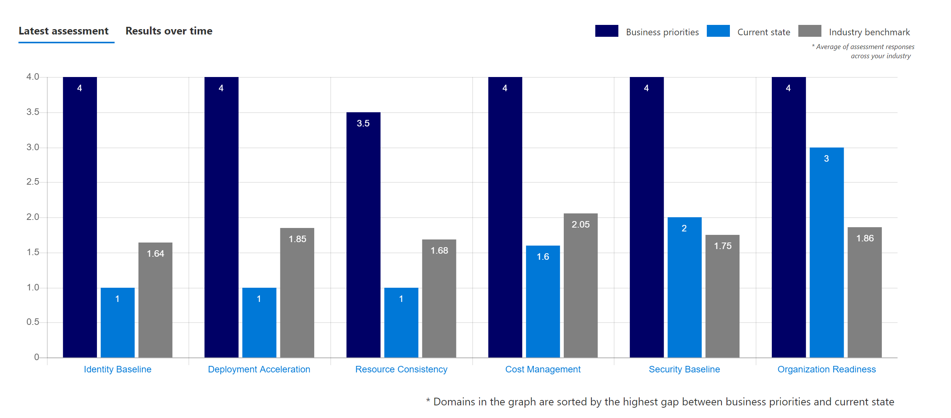
Governance Benchmark Assessment Results

Slide 7
Recommendations – Next Steps
Refine & validate
01
Harden business case with additional detail - app refactoring costs
Compare Industry vs. Contoso’s actual data
Develop and Deploy
02
Custom Skilling Plan for Contoso
Cloud Centre of Excellence
Joint Transformation Office
High level governance framework
04
Map roles to individuals
Identify Stakeholders and Executive Sponsors
Identify and prioritize
03
Assess workloads based on complexity, cost and value to business
Move on simple workloads to get quick wins

Slide 9
Appendix

Slide 10
Challenges for Contoso
Drivers
Dependent on demand from downstream construction industries, including residential, commercial & industrial building.
Profitability - Commoditization driving down margins for land surveys
Productivity – Drive service and operational efficiencies
Time-to-Market – new value-added services
Customer Satisfaction – higher quality surveys and services that improve accuracy and greater customer ROI
Transformation areas
Drive operational IT efficiencies across business units with standards
Leverage advanced technology to expand survey capabilities, improve efficiencies, & provide deeper insights in surveys
Market
Global surveying and mapping market reached a value of nearly $37.4 billion in 2018

Slide 11
Governance Benchmark Assessment Results (Part 2)
IDENTITY/SECURITY Asset classification Data encryption Network isolation Securing connectivity Monitoring Security reviews | RESOURCE MANAGEMENT Resource tagging (e.g. for cost, criticality, SLA) Subscription governance Standardisation of patching schedules /mechanism Monitoring Disaster recovery & backup | DEPLOYMENT READINESS Deployment templates/scripts Monitoring metrics/diagnostics Configuration security reviews | COST MANAGEMENT Asset assignment to billing units/workloads Budgetary limits Underutilisation Overprovisioned Assets Over-optimsation | ORGANIZATION READINESS Sufficient access controls Overprovisioned access Authentication mechanisms Identity providers Identity reviews

Slide 12
IT Spend Categories
Revenue | $ 1,300,000,000.00
IT Spend | $ 61,100,000.00
Industry | Pro Services
IT Spend Categories | Costs | Percent of IT Spend
Data Centre | $ 13,442,000.00 | 22%
End User Compute | $ 7,332,000.00 | 12%
App Dev | $ 10,998,000.00 | 18%
App Support | $ 12,220,000.00 | 20%
IT Service Desk | $ 3,055,000.00 | 5%
Voice/Data | $ 9,165,000.00 | 15%
IT Management | $ 4,888,000.00 | 8%

Slide 13
Country Alignment Costs

Slide 14
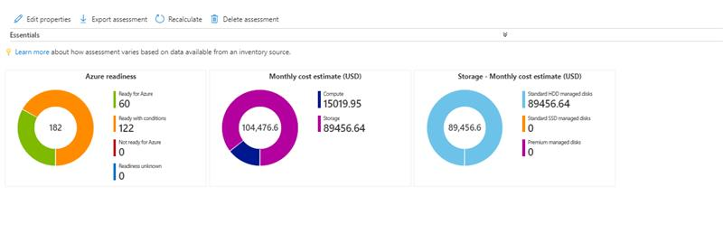
Azure Spend from Azure Migrate Calculator

Slide 15
Vision
Now
Keeping the “lights on”
IT is a cost center
Increased risk/cost due to requirement of personnel in hazardous working conditions (i.e. underwater, mines, etc.)
Limited market opportunity with existing delivery approach.
Future
Reduced cost of delivery with highly automated cloud-based services and a reduced set of applications.
IT as a business enabler and partner
Leveraging technology (drones, augmented reality) to perform surveys quicker, cheaper, and more safely.
New market opportunities through leveraging enhanced survey technology
MS Enablers
“Pay for what you use” (Opex) and globally scalable cloud services (PaaS) with extensive hybrid cloud capability.
Operational expertise around cloud management processes and operational efficiency (Premier support, MSIT, Product Team)
Reduced time to market for more agile response to new opportunities, competitive forces
Internet of Things (IoT) and Augmented Reality (AR) solutions within an end-to-end global scale cloud ecosystem

Slide 16

Augmenting Your Organization
Skilling
Certifications
Etc.
CIO
Datacenter
End User Compute
AppDev
IT Service Desk
Voice and Data
IT Management
App Support
CIO
Voice and Data
IT Governance and Compliance
Cloud Center of Excellence
End User Compute
DevOps
IT Service Desk
Data Analytics
Business Strategy
Center for Innovation

